Slide 1
Simad University Faculty of Computing Operating Systems (I) Assignment of Chapter 7, 8 and 9

Slide 2
1. Using Resource Allocation Graph concept with one resource instance in each resource type, show whether or not there might be a deadlock: R2P 1R1 P2R3P3 R2 P2 R1 R3
.
.
P1
P2
P3
. .
R2

Slide 3
2-Using Segmentation concept, the following segment are numbers from 0 to 4. Store them in physical memory
Physical memory
LIMIT | BASE
1000 | 0900
700 | 6300
1600 | 3200
1000 | 1950
1000 | 4700
Segment 0
Segment 3
Segment 2
Segment 4
Segment 1
0900
1900
1950
2950
3200
4800
4700
5700
6300
7000

Slide 4
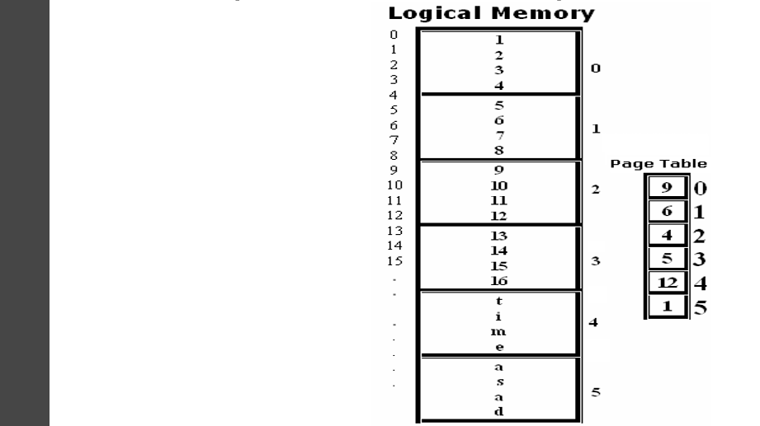
3.Using paging concept with direct mapping, translate the below logical memory contents into a real memory.
physical memory
0
4
8
12
16
20
24
28
32
36
40
44
48
A,s,a,d
9,10,11,12
13,14,15,16
5,6,7,8
1,2,3,4
T,I,M,E

Slide 5
4.Compute external fragmentation of the following table calculate compaction
1) Move to 900k
2) Move to 550k
3) Move to 650k
OS
P1
P2
500K
P3
400K
P4
150K
OS
p1
p2
p3
p4
1050k
OS
P1
P2
1050K
P3
P4
OS
P1
P2
P3
1050K
P4

Slide 6
5. Using First Fit, Best Fit and Worst Fit, allocate B4 and B5 with 250K and 150K respectively
1) first-T FIT
2) BES-T FIT
3) WORTS - FIT
OS
P1
P4
50K
P2
P5
300K
P3
150K
250K
700K
OS
P1
300K
P2
450K
P3
P5
P4
700K
OS
P1
300K
P2
P5
300K
P3
150
250K
P4
450K
OS
P1
300K
P2
450K
P3
150K
250
700K

Slide 7
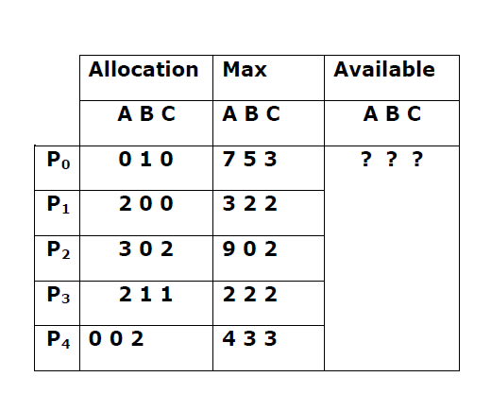
6. Using Banker Algorithm for deadlock Avoidance, System with 5 processes (P0 through P4) and 3 resource types of A (14 instances), B (4 instances), and C (8 instances). At time T0, the system has the below table Snapshot. What is the status of available and Need matrices, safe sequence and then Calculate to see if Requests of P1(3,0,2) can cause the system to enter into deadlock state

Slide 8
Solution
Allocation | Max | Available | Need
ABC | ABC | ABC | ABC
010 | 753 | 302
200 | 322 | 502
302 | 902 | 713
211 | 222 | 715
002 | 433 | 1017
P0
P1
P2
P3
P4
1027

Slide 9
Need <=work →work +Allocation
P0=743<=302 skip
P1=122<=302 so, 302+200=502
P2=600<=502 skip
P3=011<=502 so, 502+211=713
P4=433<=713 so, 713+002=715
P0=743<=715 skip
P2=600<=715 so, 715+302=1017
P0=743<=1017 so, 1017+010=1027
Save sequence[p1,p3,p4,p2,p1]

Slide 10
End

